Slide 1

Fingerprint lock with Arduino nano
By Ahsan, Hamza, Alex and Cameron
Notes:
Ahsan
Hello welcome all to our presentation. I’m Ahsan the group leader of this project and wanted to talk about our project which is about a Fingerprint lock with an Arduino Nano, In this presentation we will go over why we choose this project, the objectives and basic specifications of the product. The hardware and software details of the project and how we will test the project via the use of strategies. We will also include our Gantt Chart to show where we are in terms of the project and how much more we have left.

Slide 2
Roles and Responsibilities
Ahsan : Group Leader : Overlooking group project and ensuring group sticks to tasks
Hamza : Secretary : Helps wherever possible and coordinating meetings
Alex : Hardware Engineer
Cameron : Software Engineer
Notes:
First and foremost, I would like to introduce each of the members of the group and the responsibilities of each member, so everyone has an idea on what each member of the group is responsible for.

Slide 3
Why a Fingerprint Lock?

Slide 4
Basic System Objectives
1
The system must be able to store and manage multiple individual fingerprints.
2
The system must be able to accurately and reliably identify authorized individuals based on their fingerprints.
3
The system must be secure and resistant to tampering or unauthorized access.
4
The system must be able to grant or deny access to the secure area based on the verification results.
Notes:
2. So that there is no clash between the fingerprints
4. We two different coloured led for that.

Slide 5

Basic Specification of the Fingerprint Scanner
The system will use an optical fingerprint scanner.
The system will use the flash memory microprocessor to store the fingerprint.
The system will use the database of fingerprints in the flash memory to identify, and reject any false fingerprint.

Slide 6
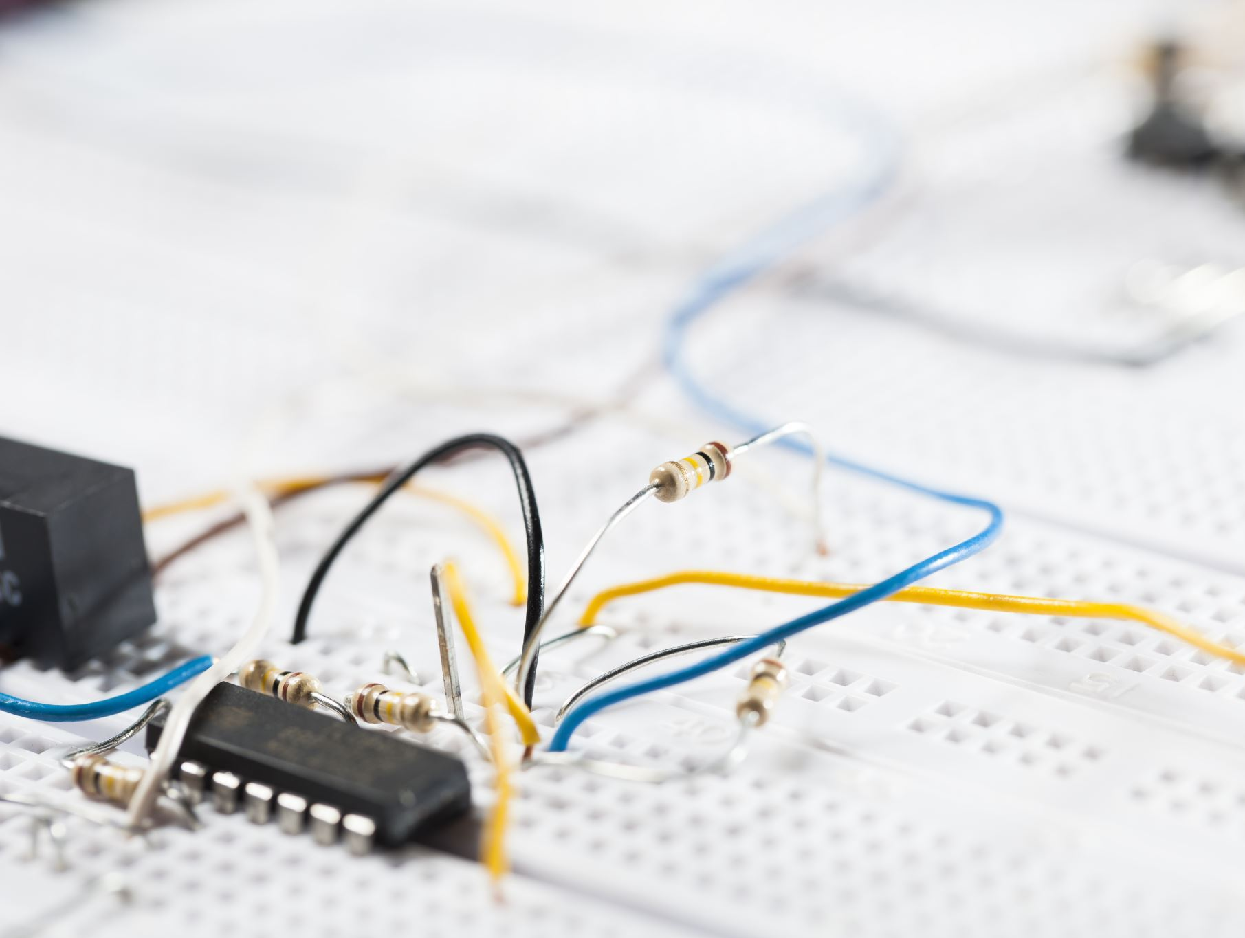
System Constraints & Assumptions
The system can be installed and used in a single location with a fixed secure area.
The system will be connected to a power source.
The system will be used by individuals with stable fingerprints.

Slide 7
System Tolerances
The system must have a high degree of accuracy, with a false acceptance rate (FAR) of no more than 0.001% and a false rejection rate (FRR) of no more than 1%.
The system must be able to operate in a range of environmental conditions, including temperatures between -10°C and 50°C and relative humidity between 20% and 80%.
The system must be able to operate continuously for at least 12 hours on a single battery charge.
Notes:
alex

Slide 8
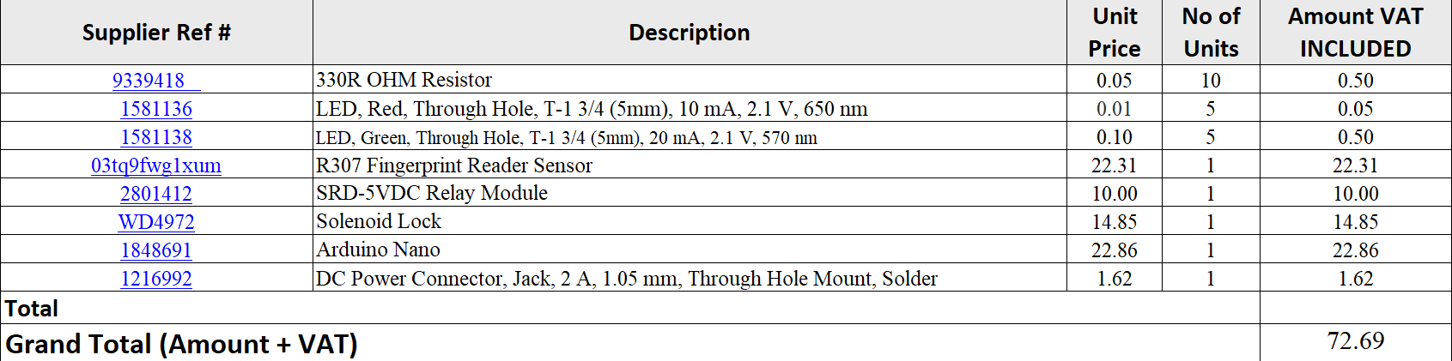
Bill of Materials / Expenditure Description

Slide 9
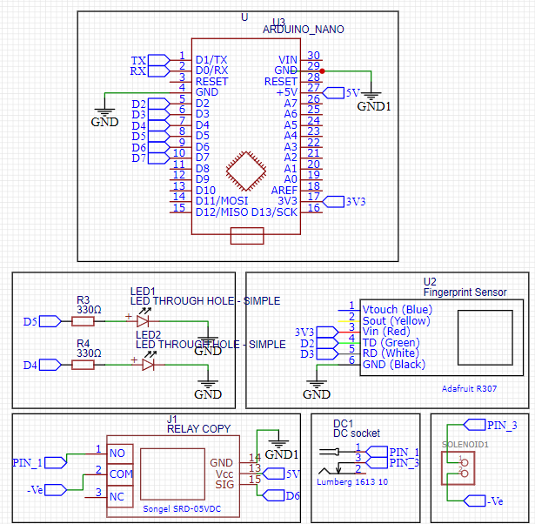
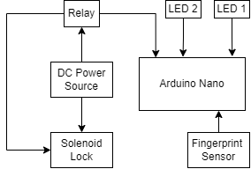
Schematic Diagram & Block Diagram and : Hardware
Notes:
Hamza
Main Arduino
relay and solenoid connect to 12v dc because high powered Arduino supply’s 5v max
Fingerpritn sensor connected to Arduino signal to relay opens the solenoid

Slide 10
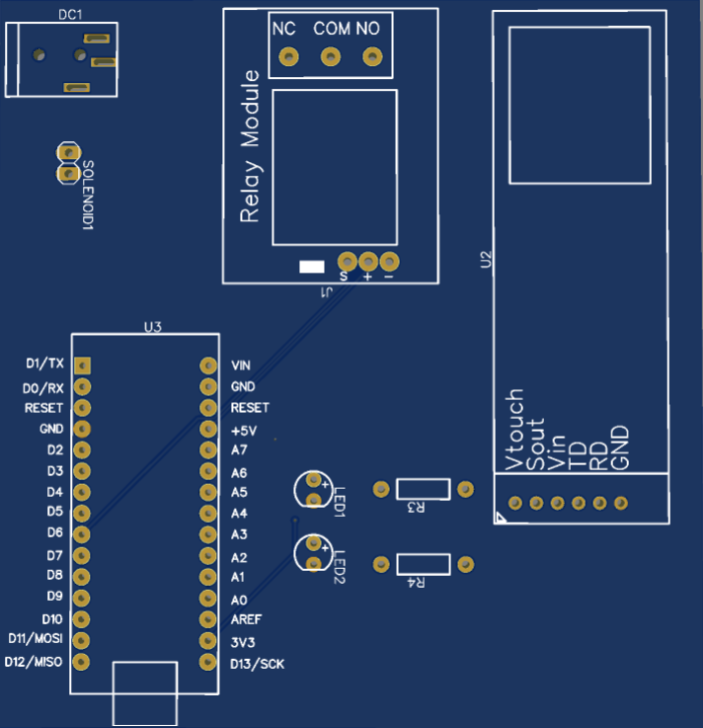
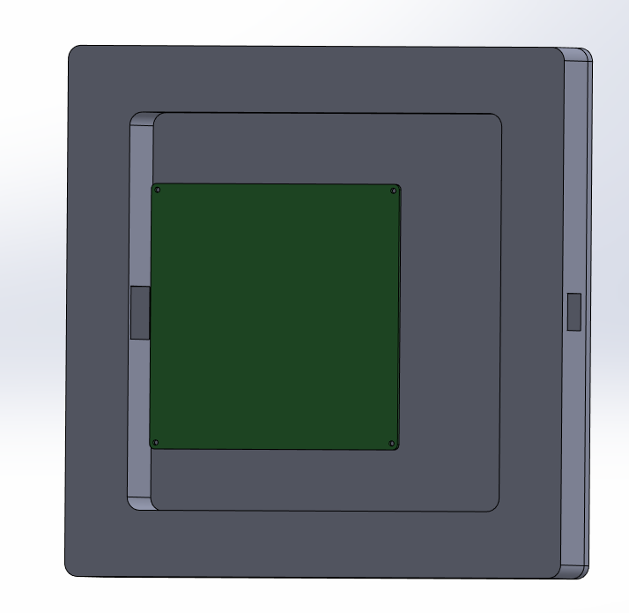
Product Artifact and PCB
Notes:
Hamza

Slide 11
Testing Strategy
Functional Testing
Reliability Testing
Safety Testing
User Experience Testing
Notes:
Hamza and Cameron
There are several testing strategies that you can use to test an electrical product, including the following:
Functional testing: This type of testing involves verifying that the product performs all of its intended functions correctly. This can include testing individual components, such as buttons, switches, and sensors, as well as testing the product as a whole to ensure that all of its functions work together properly.
Reliability testing: This type of testing is used to verify that the product is able to withstand the stresses of normal use and continue to function properly over time. This can include testing the product's durability, longevity, and resistance to damage or failure.
Safety testing: This type of testing is used to verify that the product is safe to use, both for the user and for any other individuals who may come into contact with it. This can include testing the product's electrical safety, such as ensuring that it complies with relevant safety standards and regulations.
User experience testing: This type of testing is used to evaluate how easy the product is to use and how well it meets the needs of the user. This can include testing the product's user interface, usability, and overall user experience.
These are just some examples of testing strategies that you can use to test an electrical product. The specific tests that you use will depend on the product and its intended use, and you may need to use a combination of different testing methods to thoroughly evaluate the product.

Slide 12
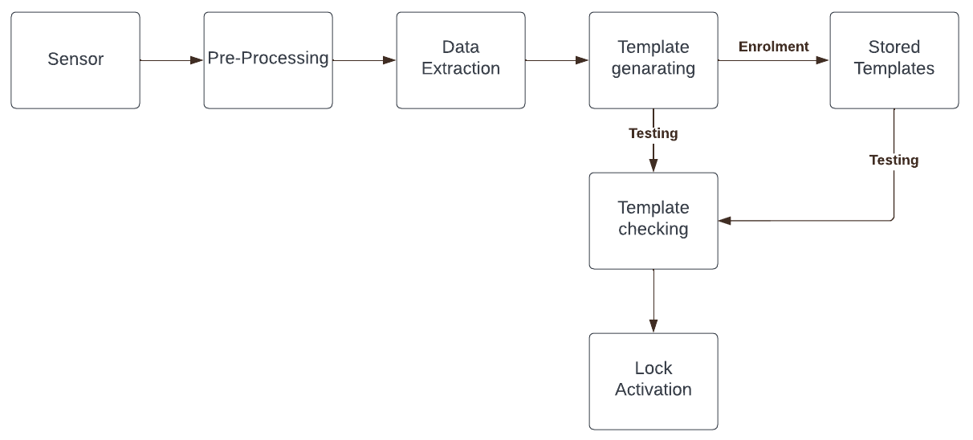
Block Diagram and Specifications : Software
Notes:
Cameron

Slide 13
Risk Assessment
Risk No. | Description of the risk | Probability of the risk | Effect on the project | Contingencies/actions To mitigate the risk
1 | Burn from soldering iron. | If soldering iron is handled with care, probability of risk happening is low. | Can slow progress down as person will have to take care of injuries. | Wear heat proof gloves.
2 | Burn from hot solder splashing. | Fairly high probability of risk happening. | Takes up time but needing to take extra care is important for safety. | Wear long sleeves to protect skin and wear safety goggles to protect eyes.
3 | Short Circuit causing heat and possible fire. | High if components are damaged or not connected properly, very low if everything is connected as it should be. | Take extra time in building process as lots of attention will need to be put into the build to mitigate risk. | Test every component and connection/solder join, to make sure everything is in working order. This can be done easily by using a multimeter.
4. | Physical impact to fingers from building the product. | Fairly high if not being careful. Low if extra care is taken and you’re paying full attention to what you’re doing. | This will take extra time as it is most important to be safe when physically building the chassis of our product. | Keeping aware of surroundings and using building tools appropriately.
5. | Burn from welding | Heat and sparks could burn when welding, high probability without appropriate gear. | Will be strongest way of constructing our project but requires the correct knowledge on how to weld. | Wear correct protective gear and face shield, have the knowledge on welding techniques and methods.

Slide 14

Gantt Chart

Slide 15
Thank You for listening Any questions?
Notes:
Ahsan

